Slide 1
AVIS

Slide 2
Change is the only constant, and AVIS is the change that will alter the way you perceive the future.

Slide 3
What is AVIS?
1
….and how it can make your work easier.

Slide 4
Let’s get into definitions
AVIS is real-time data monitoring, control, and automation system which can be used in a wide range of scenarios. The device is a highly versatile, programable microcontroller which has its core around IoT (Internet of Things).

Slide 5
What can AVIS do?
2

Slide 6
Data Monitoring
Gather data from multiple devices like GPS, on-field sensors etc
Want operational data from devices like motors, pumps, conveyors?
  Don’t worry, we got that covered too.
  We provide customised solutions that covers a wide range of scenarios.
Like charts and graphs?
  The website is customised according to your necessities and requirements. So, you may have it all.
Error logging and reporting
  Get to know status of your equipment, and how they behave.

Slide 7
Data Analysis
Collect data and analyse it, perform mathematical operations, view everything in graphical format.
  We offer powerful mathematical tools with which you can operate on your data sets.
  See how they behave graphically.
  If you find the correct relationships, then you may even save/download you work.

Slide 8
Automation and Control
Get control over your equipment, from anywhere!
  Control all your devices from one central location.
  Need logical control? We can handle that too!
  All your important equipment are wired so that they are always online.

Slide 9
How does it work?
3

Slide 10
AVIS = IoT
Harness the power of 4G networks. Use it to make your life easier.

Slide 11
The design
Controller
Cloud
Website
AVIS system works by communicating to the website through the internet via a cloud database system. This includes a lot of complex steps but we handle that for you!

Slide 12
What if there is no INTERNET!
Your Crucial System are “WIRED”
Don’t worry, we will not let your crucial system get offline even for a millisecond! All the high-end systems will be wired
Polling for Data Transmission
Real-time data collection will not be tampered. You will still receive the data that was collected when there was no network
Or, there is always LAN!
If you don’t trust 4G networks, then you can provide us with LAN connection and we will get your system up and running.

Slide 13
What does AVIS include?
4

Slide 14
AVIS has two parts to it
AVIS Controller
This is a state-of-the-art technology equipped control system which gives immense power to you and your systems.
AVIS Website
This is the interface to the entire system. It offers you a wide range of features and customisation options.

Slide 15
AVIS Controller
Supports multiple interfacing options: I2C, SPI, UART, R232 etc.
Can support up to 24 digital inputs/outputs.
With 1GB of RAM and up to 128GB of disk space, this device can achieve a lot!
CPU
It contains a robust and versatile microprocessor powered by a Broadcom chip.
Interfacing Option
Inputs/Outputs
Power
Connectivity
The device comes in two modes: with a GSM module which makes it ready for IoT applications, and one without it in which case it uses on-site LAN connection

Slide 16
AVIS Website
The website is the interface to:
View the data collected by the AVIS controller remotely in real-time
Perform real-time device control
Data Processing
Action centre to act on certain triggers based on the data sets
Password protected to bar unauthorised access
Can be customised to the specifications of the users

Slide 17
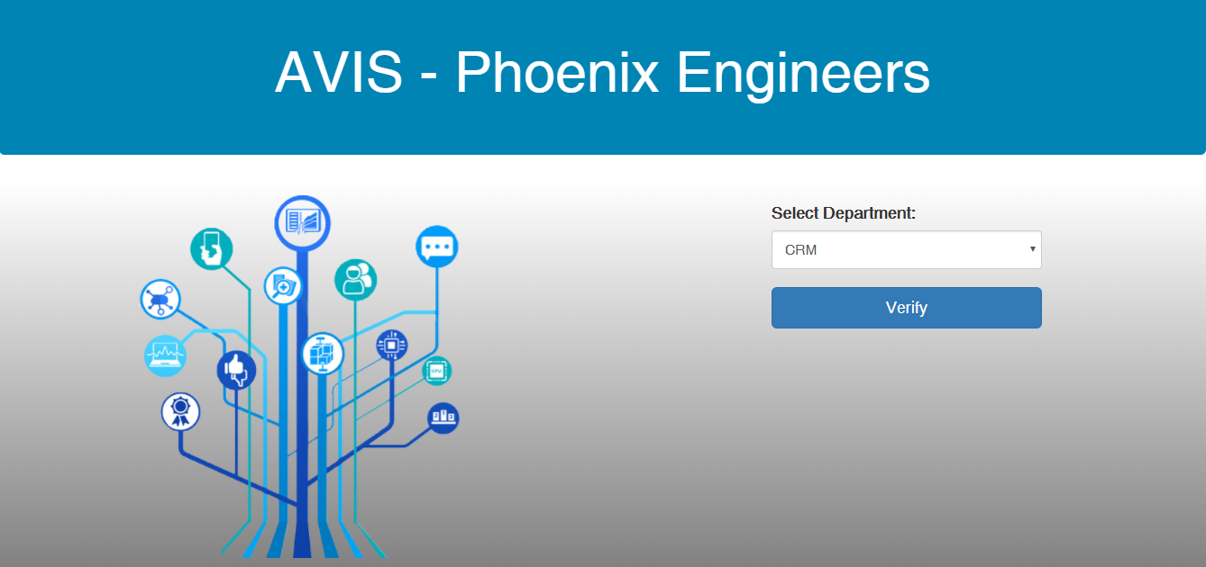
How is looks?
Take a look. You be the judge!

Slide 18
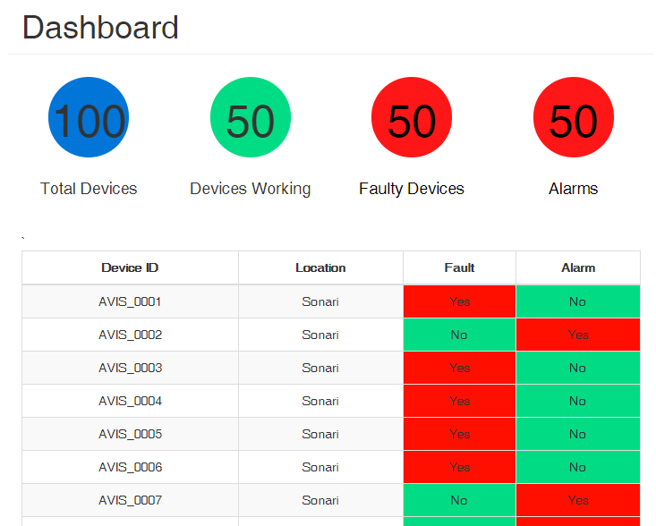
Tablet View/Mobile View

Slide 19
Place your screenshot here
Mobile View

Slide 20
Projects on the way…
AVIS
CRM, Tata Steel, Jsr
Noamundi, Tata Steel
Khondbond mines area, Tata Steel
HSM, Tata Steel

Slide 21
Why AVIS?
Less hassles
Gets more done
Saves time
Saves Money
Better understand your systems
Error Logging and reporting
Modular design
Built for the Industry

Slide 22
To summarise, AVIS can..

Slide 23
Finally, no matter where you are, always stay in control.
Turn On Motors

Slide 24
Thanks!
Any questions?
You can find me at:
sangam@infinitepotential.in
+91-7568945150

