Slide 1

Hospital Management System

Slide 2
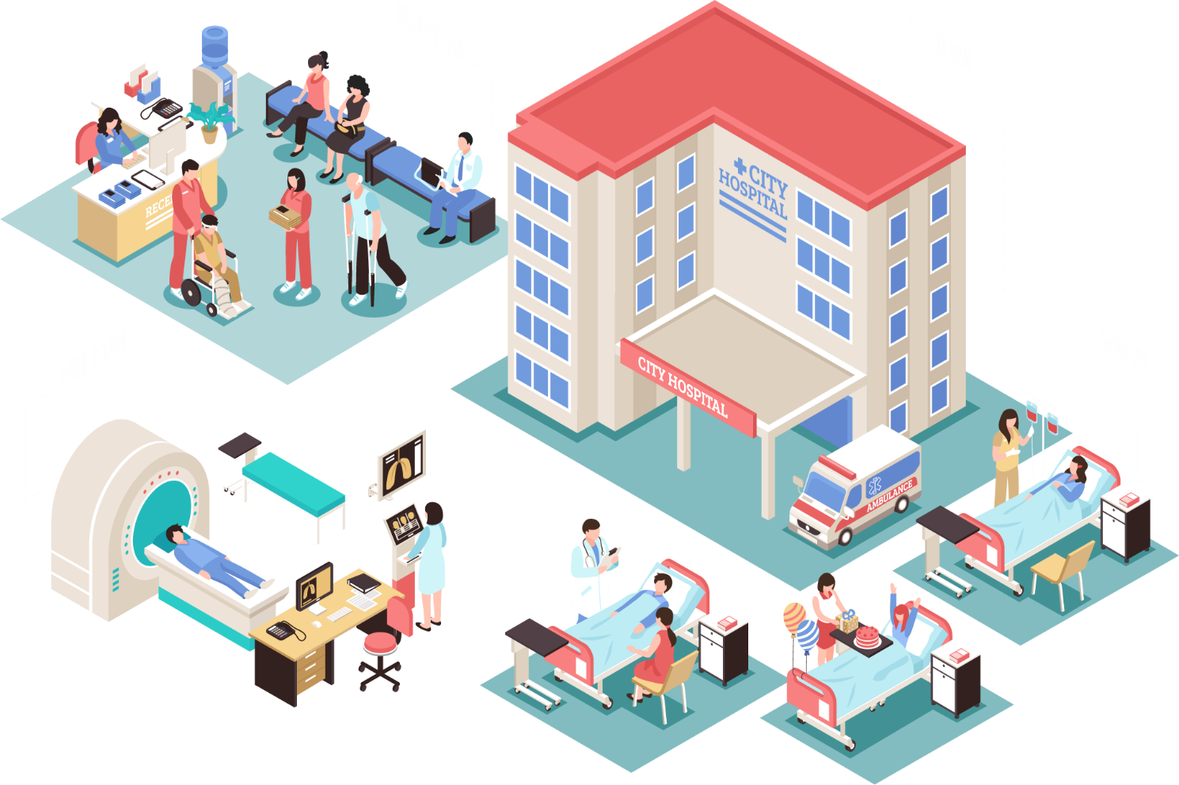
Say Hello to Heale
Heale is a customizable, comprehensive,
and integrated Hospital Management System designed to manage all hospital operations

Slide 3

What is heale?
heale is an integrated information system for managing all aspects of a hospital’s operations such as medical, financial, administrative, legal, and compliance. It includes electronic health records, business intelligence, and revenue cycle management
heale allows easy access to patient data to generate various records, including classification based on demographic, gender, age, and so on. It is especially beneficial at the ambulatory point, hence enhancing continuity of care. Internet-based access improves the ability to access such data remotely.

Slide 4
Benefits
Improved Processes
Digital medical records
Staff interaction
Automation is one of the main benefits here. It helps to optimize the user experience. Medical specialists, patients, and hospital authorities can interact online, make the appointments and exchange information.
The hospital database includes all the necessary patient data. The disease history, test results, prescribed treatment can be accessed by doctors without much delay in order to make an accurate diagnosis and monitor the patient’s health. It enables lower risks of mistakes.
It is vital to engage all of your employees for improved coordination and teamwork. They do not need to make special requests and wait for a long time for an answer. Each specialist will be in charge of certain process stage and can share outcomes with colleagues just in one click.

Slide 5
Benefits
Facility management
Financial control and tax
planning
Patient self-service
Hospitals authorities are able to manage their available resources, analyze staff work, reduce the equipment downtime, optimize the supply chain, etc. Another fact to mention is that hospital staff deal with the digital data instead of endless paperwork.
The management has the ability to monitor different financial operations including expenses, profits, and losses, paying bills and taxes, in and outpatient billing. The financial awareness helps to analyze business prospects quite clear and move in the right direction
It is vital to engage all of your employees for improved coordination and teamwork. They do not need to make special requests and wait for a long time for an answer. Each specialist will be in charge of certain process stage and can share outcomes with colleagues just in one click.

Slide 6

Benefits
And above all
a better customer experience
Since the clinic management system is patient-oriented, the treatment process can be less stressful. Doctors have more time for the examination and interaction with patients. In addition, all the requested information can be received online.

Slide 7





Features
Web Based Portal
Analytics
Responsive Design
All your data safe and secure on the cloud and easily accessible from anywhere on earth!
Keeps records of all patient data. So more in-depth analytics be performed to optimize operations
Access from Laptop, Desktop, Tablet or even from your mobile!
Secure
Online Payments
Cost Effective
Heale is protected by industry grade security and keeps your data safe from unwanted people and bots!
Collect payments from patients on the fly without having to handle cash.
We offer a economical and competitive pricing. We take care of the server charges and maintenance so you don't have to!

Slide 8
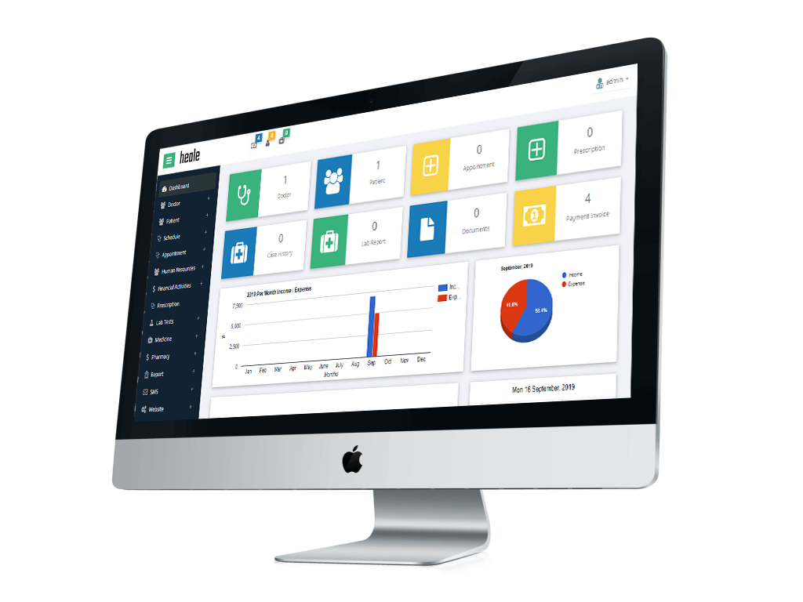
Included
Modules
Doctor Management
Pharmacy Management
Tracks consultant charges for outpatient and inpatient visits and procedures. Option for defining consultation charges based on the procedures/ department.
A complete pharmacy shop can be managed through this module. Receive prescriptions from consulting doctors; send dispensing unit down to a particular patient, without any need for manual intervention
Patient Management
Appointment Booking
This module of our hospital management system is designed to manage vital. It encompasses the patient’s name, address and contact information, medical records and history
The Appointment & Scheduling module of our hospital management system is designed to manage the effective scheduling of appointments of patients for the doctors, laboratory etc.
Human Resource
Management
Laboratory Management
HR Management module manages HR department and keeps track of all of your staff
Laboratory Management module of hospital management system is used by the pathology lab to record and disseminate the information regarding the tests performed

Slide 9
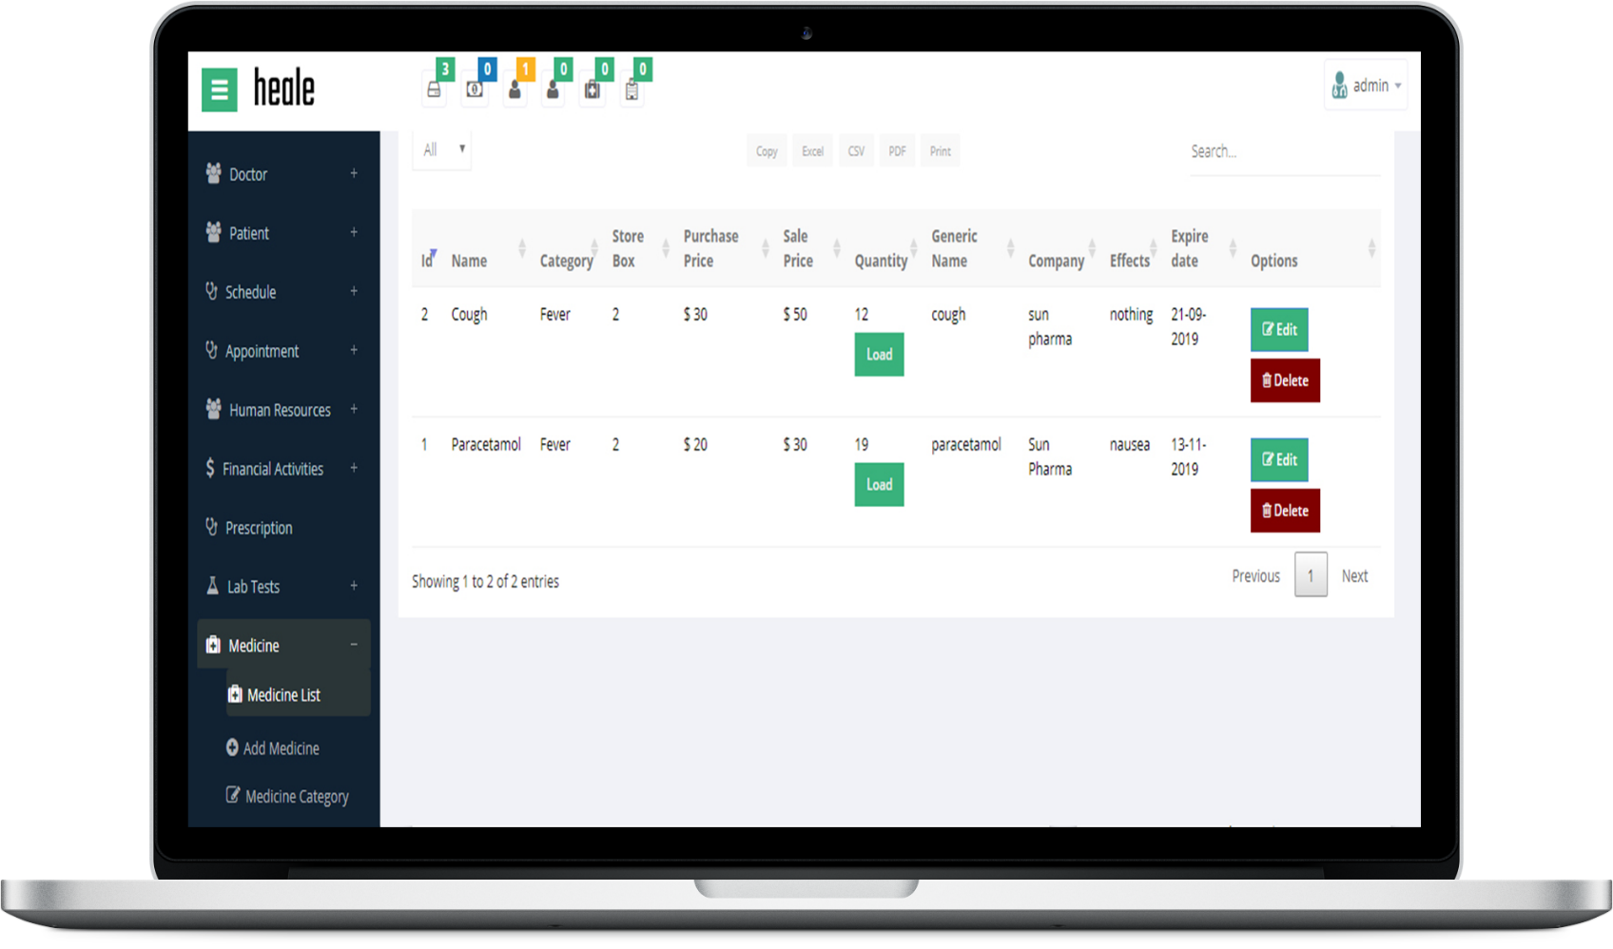
Included
Modules
Reception Management
Inbuilt SMS/Email/Messaging
Manages front desk reception activities. Status of any patient/doctor can be queried from this module, e.g., timing of consultant, residential address/patient room search.
Have a message you need to communicate urgently? Send out a text or an email to your patients or staff right from the dashboard
Blood Bank Management
Noticeboard
Blood Bank Management module provides the platform for the critical functionalities of a Blood bank, encompassing a blood request process and the issuance and management of stock.
Let your staff and patients know about important events and happenings using the Noticeboard
Finance & Accounting
Financial activities module manages all the financial transactions and reports of the hospital. Users can create payments, invoices & expenses.
And many more….
We’re constantly working to include more and more groundbreaking features into the system

Slide 10

Get in touch with one of our executives now to request a demo.

